Slide 1
Vancomycin Management Standard of Practice

Slide 2
Objectives
Discuss the pharmacokinetics/pharmacodynamics of vancomycin.
Describe optimal vancomycin monitoring methods.
Apply dosing and monitoring strategies using a patient case.

Slide 3
Definitions
Pharmacy to Manage (PTM):
The formal pharmacy consult order directing pharmacist-led dosing and monitoring of policy-specified medications.
Therapeutic Drug Monitoring (TDM):
The use of assay procedures for determination of drug concentrations in plasma, and the interpretation and application of the resulting concentration data to develop safe and effective regimens.
C1 (2-Hour Post Dose AUC Level):
Serum drug concentration collected roughly two hours after the end of the infusion
C2 (Trough concentration):
Serum drug concentration collected near the end of the dosing interval
Spruill WJ, et al. Concepts in Clinical Pharmacokinetics. 6th ed. 2014:4-6.

Slide 4
Pharmacokinetics and Pharmacodynamics

Slide 5
What is AUC/MIC ?
Area Under the Curve/Minimum Inhibitory Concentration (AUC/MIC)
Integrated quantity of cumulative drug exposure for a defined period of time
AKA: The average serum drug concentration during that time period
Goal AUC
Target: 500 mcg*h/mL
Range 400-600 mcg*h/mL
Peak
Concentration
AUC
MIC
Patel N, et al. Clin Infect Dis. 2011; 52 (8): 969-974.
Rybak MJ. Clin Infect Dis. 2006;42(Suppl 1):S35-39.
Ebert S. 27th Interscience Conference on Antimicrobial Agents and Chemotherapy. ICAAC. 1987.
Moise-Broder PA, et al. Clin Pharmacokinet. 2004;43(13):925-942.
Craig WA. Clin Infect Dis. 1998;26(1):1-10.
Pai MP, et al. Adv Drug Deliv Rev. 2014;77:50-57.
Trough
Time

Slide 6
AUC/MIC vs AUC
This institution will use AUC rather than AUC/MIC
MICs > 1 mcg/mL
MIC is typically not available until 72-96 hours after starting therapy
AUC/MIC = AUC
Could be due to expected variability in the antimicrobial susceptibility testing methods
More than 90% of vancomycin MICs for S. aureus at our institution equal 1 mcg/mL

Slide 7
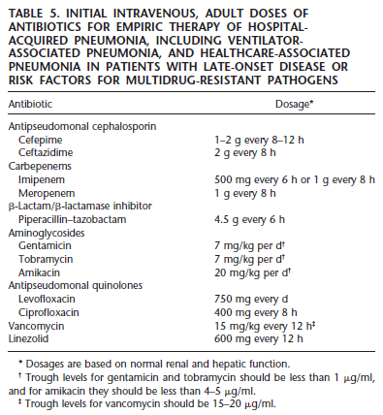
Trough Concentrations Appear in Guidelines Circa 2005
American Thoracic Society. Am J Respir Crit Care Med. 2005;171(4):388-416.

Slide 8
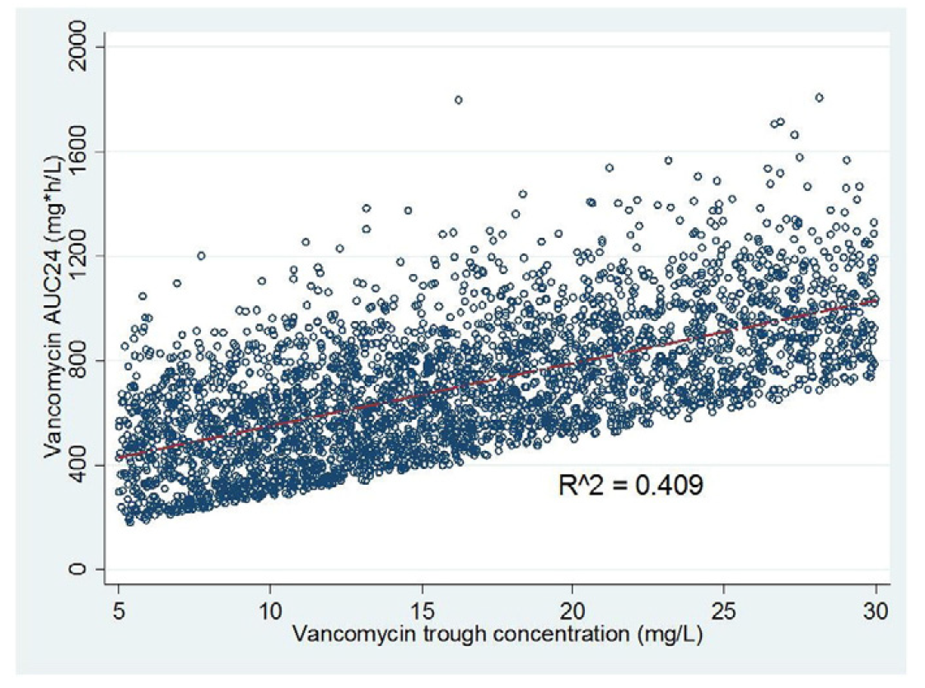
Troughs DO NOT Correlate with AUC
Troughs 15-20 mg/L underestimate a patient’s true AUC by 25%
Two-level AUC equations and Bayesian methods underestimate a patient’s true AUC by 2-3%
Pai MP, et al. Adv Drug Deliv Rev. 2014;77:50-57.
Neely MN, et al. Antimicrob Agents Chemother. 2014;58(1):309-316.

Slide 9
Patient-Specific PK Data
Patient 1:
AUC₁ 467 mcg*h/mL
Peak₁ 34 mcg/mL
Trough₁ 16 mcg/mL
Peak₁
Concentration
AUC₁
Trough₁
Time

Slide 10
Patient-Specific PK Data
Peak₂
Patient 2:
AUC₂ 870 mcg*h/mL
Peak₂ 57 mcg/mL
Trough₂ 16 mcg/mL
AUC₂
Concentration
Trough₂
Time

Slide 11
Identical Troughs DO NOT Equal Identical AUC
Patient 1:
AUC₁ 467 mcg*h/mL
Peak₁ 34 mcg/mL
Trough₁ 16 mcg/mL
Patient 2:
AUC₂ 870 mcg*h/mL
Peak₂ 57 mcg/mL
Trough₂ 16 mcg/mL
Peak₂
AUC₂
Peak₁
Concentration
AUC₁
Trough₁ & Trough₂
Time

Slide 12
Clinical Outcomes Data

Slide 13
Safety
Troughs and AKI | AUC and AKI
≥ 15 mcg/mL OR 2.74 (95% CI 1.94-3.88) | > 563 mcg*h/mL OR 2.74 (95% CI 1.94-3.88) ≥ 677 vs < 677 mcg*h/mL 65.0% vs 33.3% (p=0.004) ≥ 1300 vs < 1300 mcg*h/mL 33.3% vs 13.8% (p=0.05)
AUC threshold for AKI is likely a range of 600-800 mcg*h/mL
Chavada R, et al. Antimicrob Agents Chemother. 2017;61(5):e02535-16.
Lodise TP, et al. Clin Infect Dis. 2009;49(4):507-514.
Patel N, et al. Clin Infect Dis. 2011;52(8):969-974.
Pai MP, et al. Adv Drug Deliv Rev. 2014;77:50-57.
Zasowski EJ, et al. Antimicrob Agents Chemother. 2018;62(1):e01684-17.

Slide 14
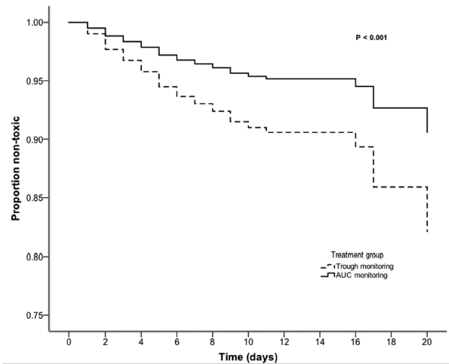
Safety: Troughs vs AUC
AUC monitoring has been shown to reduce the rate of AKI by 50% compared to trough monitoring
HR 0.50 (95% CI 0.33-0.75)
Finch NA, et al. Antimicrob Agents Chemother. 2017;61(12):e01293-17.

Slide 15
Efficacy
Study | Population | Outcomes | Result | Conclusion
Kullar, et al. 2011. | N=320 MRSA Bacteremia | Treatment failure: Troughs 15-20 vs 10-14.9 | 57.8% vs 39.5% p=0.016 | Treatment failure reduction
 |  | Treatment failure: AUC/MIC ≥ 421 vs AUC/MIC < 421 | 61.2% vs 48.6% p=0.038 | Treatment failure reduction
Prybylski. 2015. | N=1677 MRSA Bacteremia | Treatment failure: Troughs ≥ 15 vs 10-14.9 | OR 0.87 95% CI 0.6-1.25 | No treatment failure reduction
 |  | Treatment failure: AUC/MIC > 400 | OR 0.41 95% CI 0.31-0.53 | Treatment failure reduction
Kullar R, et al. Clin Infect Dis. 2011;52(8):975-981.
Prybylski JP. Pharmacotherapy. 2015;35(10):889-898.
Notes:
One study did suggest improved clinical efficacy when targeting troughs 15-20 vs 10-14.9 for MRSA bacteremia; however there were numerous limitations. Keep in mind this study did find increased efficacy when reaching the AUC goal, as did more recent and more robust studies

Slide 16
Comparison of Trough vs AUC Monitoring
Troughs | Area Under the Curve
75% accurate Common PK/PD Target: 15-20 mcg/mL Surrogate for AUC/MIC Efficacy range = Toxicity range | 97-98% accurate Common PK/PD Target: 400-600 mcg*h/mL Patient-specific calculations Safety and potentially efficacy benefits

Slide 17
Adult Vancomycin SOP & A Patient Case

Slide 18
Key Points of Therapeutic Drug Monitoring (TDM): Institutional Recommendations
Population | AUC Goal (mcg*h/mL) | Trough Goal (mcg/mL) | Number of Concentrations Required
Unstable Renal Function^, Hemodialysis (HD) / Peritoneal Dialysis, (PD), or OPAT# | 500 (Range of 400-600 acceptable) | Unstable Renal Function: 15-20 HD/PD: 15-25 OPAT: Variable# | 1
All Others |  | Non-CNS Infection: 10-20* CNS Infection: 15-20 | 2
^ Unstable renal function: Rapidly increasing or decreasing estimated GFR
# OPAT (Outpatient Parenteral Antimicrobial Therapy): Refer to the OPAT section in the Considerations for Special Populations for more details
* Patients with uncomplicated infections and prophylaxis requiring a short duration of therapy may not require TDM. If warranted, a trough goal of 10-15 mcg/mL may be considered

Slide 19
Comparison of Therapeutic Drug Monitoring Methods
AUC: Bayesian | AUC: Trapezoidal | AUC: Total Daily Dose (TDD)
1-2 levels required: Regardless of timing Costly software application Complex and impractical for institutions on a large-scale level | 2 levels required: 2 h post-infusion and trough 1st order PK equations used for AMGs: Ke, Vd, Cmax, etc. AUC_{Inf}: $\frac{Cmax + Cmin}{2} ∗ Δt$ AUC_{Elim}: $\frac{Cmax − Cmin}{Ke}$ AUC = AUC_{Inf} + AUC_{Elim} | 2 levels required: 2 h post-infusion and trough 1st order PK equations used for AMGs: Similar to trapezoidal method AUC = $\frac{TDD}{Ke ∗Vd}$
Rybak M, et al. Am J Health-Syst Pharm. 2009;66(1):82-98.
Pai MP, et al. Adv Drug Deliv Rev. 2014;77:50-57.
Neely MN, et al. Antimicrob Agents Chemother. 2018;62(2):e02042-17.
Turner RB, et al. Pharmacotherapy. 2018;38(12):1174-1183.
Finch NA, et al. Antimicrob Agents Chemother. 2017;61(12):e01293-17.
Lewis P. Ther Drug Monit. 2017. doi: 10.1097/FTD.0000000000000500.

Slide 20
Patient Case
54 YOF with PMH of IVDU, T2DM, and HTN presents to the ED with fever and generalized malaise. A vegetation was noted on a native tricuspid valve via a bedside echocardiogram.
Temp 38.5 | BP 84/62 | P 130 | RR 28 | Lactate 3.4
ABW 85 kg | Ht 175 cm | BMI 27.8
The ED team wants to start vancomycin PTM and piperacillin/tazobactam 4.5 g IV Q6h for suspected endocarditis.
11.9
133
98
22
18.5
361
95
34.6
4.4
25
1.73

Slide 21
How Do You Want to Dose and Monitor this Patient?
Loading dose?
Maintenance dosing?
Early AUC evaluation vs AUC evaluation at steady-state?

Slide 22
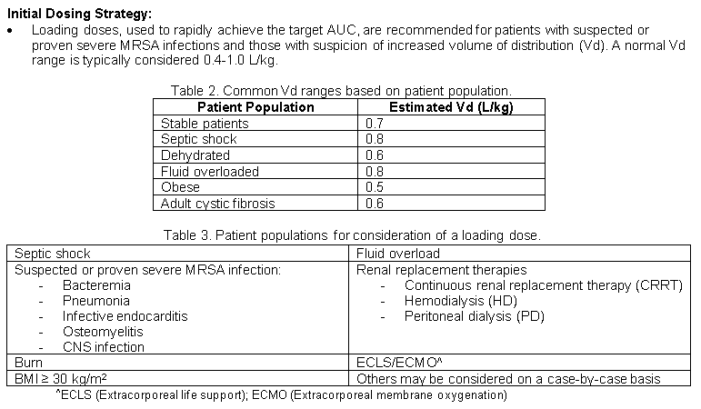
Loading Doses of 20-30 mg/kg
$Dose(mg)=$ $∆C \left(\frac{mg}{L}\right)∗Vd (L)$

Slide 23
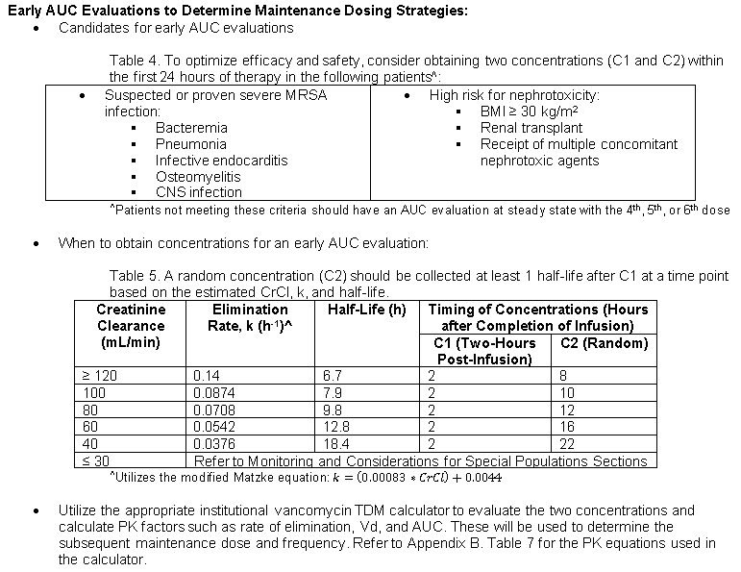
Early AUC Evaluations

Slide 24
Chronological Options for TDM
Early AUC Evaluation or Based on Preference
Dose
C1 (2H Post-Dose AUC)
C2 (Trough)
Pharmacist Evaluation
Concentration
C1
C2
Time
Steady-State Evaluation
Concentration
C1
C2 (Trough)
Dose
C1 (2H Post-Dose AUC)
Pharmacist Evaluation
C2
Time

Slide 25
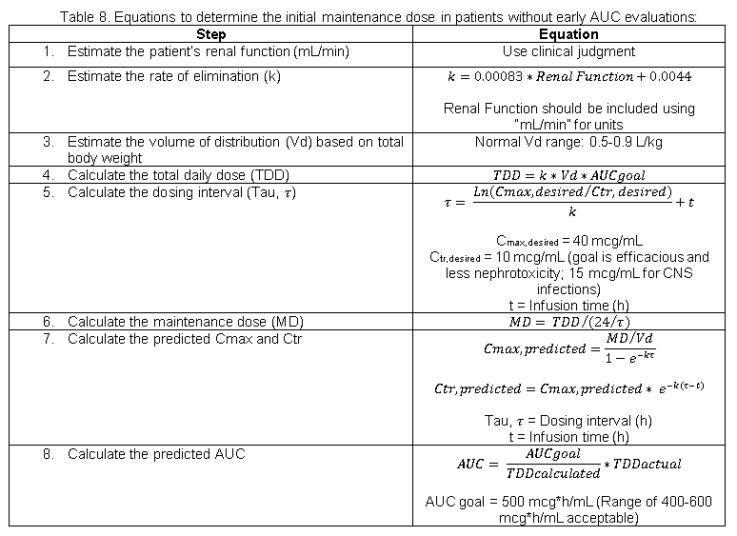
Appendix B. Maintenance Doses without Early AUC Evaluations

Slide 26
Patient Case: Early AUC Evaluation
Vancomycin 2250 mg IV (26.5 mg/kg) at 1200 over 2.5 h on day 1
C1: 39.1 mcg/mL at 1630 (2 h after end of infusion)
C2 (Random): 18.2 mcg/mL at 0630 on day 2 (16 h after end of infusion)
Cmax
Concentration
C1: 39.1 mcg/mL at 1630
Ctr
C2: 18.2 mcg/mL at 0630
Time

Slide 27
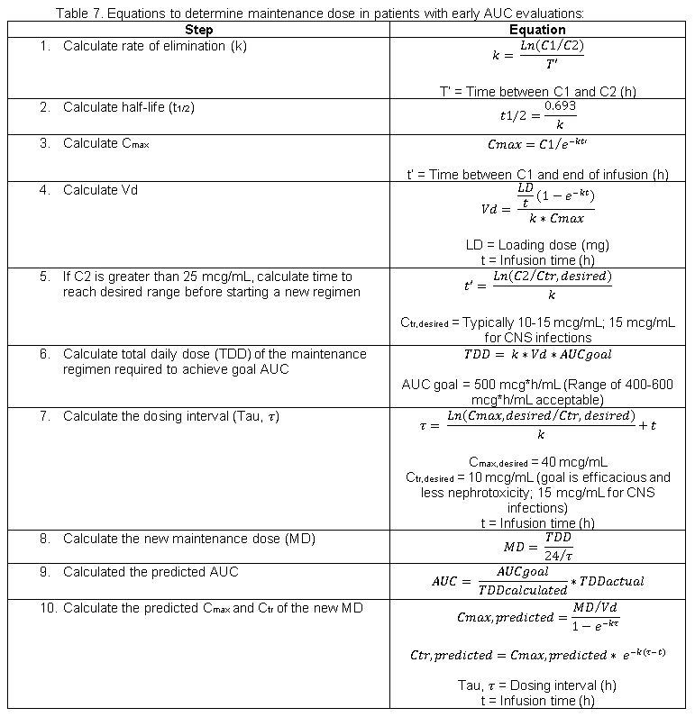
Appendix B: Early AUC Evaluation Equations

Slide 28
Patient Case: Early AUC Evaluation
Vancomycin 2250 mg IV at 1200 over 2.5 h on day 1
C1: 39.1 mcg/mL at 1630 (2 h after end of infusion)
C2 (Random): 18.2 mcg/mL at 0630 on day 2 (16 h after end of infusion)
PK Factor | Equations* | Result
1. K_{e} | K_{e} = ln (C1/C2) / ΔT | 0.055 h⁻¹
2. C_{max} | C_{max} = C1 / e ^{–k * t’} | 43.6 mcg/mL
3. V_{d} | $Vd= \frac{{Loading Dose}/t (1−e^{−kt})}{k ∗Cmax}$ | 48.2 L (0.567 L/kg)
4. TDD | $$TDD=k ∗Vd ∗AUCgoal$$ | 1316 mg → 1250-1500 mg/dose
5. Tau, τ ^ | $$\frac{{Ln (Cmax, desired}/{Ctr, desired)}}{k}+t$$ | 27.8 h
* Full list of equations found in Appendix B of the SOP
^ Cmax, desired = 40 mcg/mL; Ctr, desired = 10 mcg/mL for non-CNS infections (15 mcg/mL for CNS infections)

Slide 29
Patient Case Continued
Begin vancomycin 1500 mg IV Q24h (17.6 mg/kg) starting 24 h after giving loading dose
Predicted C_{max}: 42.5 mcg/mL
Predicted C_{tr}: 12.5 mcg/mL
Predicted AUC: 569 mcg*h/mL
Blood cultures confirmed S. aureus bacteremia; PBP2a positive (Indicates presence of MRSA)
Discontinue piperacillin/tazobactam
Recommend to continue vancomycin

Slide 30
Vancomycin MIC is > 1 mcg/mL: Do I need to Switch Therapies?
Meta-analysis of > 8000 patients with S. aureus bacteremia suggested no difference in risk of mortality when comparing high MIC (≥ 1.5 mcg/mL) vs low MIC (< 1.5 mcg/mL)
Use clinical judgment → How is the patient doing clinically?
Consider continuing vancomycin if clinically stable, including but not limited to the following:
Blood culture results are negative
Vital signs are stable
Source control is achieved
Always ask yourself: Is the vancomycin dosing strategy optimized? Or can it be optimized further?
Kalil AC, et al. JAMA. 2014;312(15):15521564.

Slide 31
Steady-State → Time to Monitor
The patient continues on vancomycin 1500 mg IV Q24h on day 4 of therapy and appears to be improving clinically.
Temp 37.4 | BP 120/80 | P 80 | RR 18 | Lactate 1.0
ABW 85 kg | Ht 175 cm | BMI 27.8
Once at steady-state: perform an AUC evaluation to adjust the dosing strategy based on potential changes in Vd and clearance.
12.3
136
105
8
13.5
375
100
35.0
4.5
22
1.20

Slide 32
Patient Case: Steady-State AUC Evaluation
C2 (Trough): 17.1 mcg/mL at 1130
Vancomycin 1500 mg IV at 1200 over 1.5 h
C1: 34.8 mcg/mL at 1530 (2 h after end of infusion)
Concentration
C1: 34.8 mcg/mL
Ctr: 17.1 mcg/mL
4th Dose
Time

Slide 33
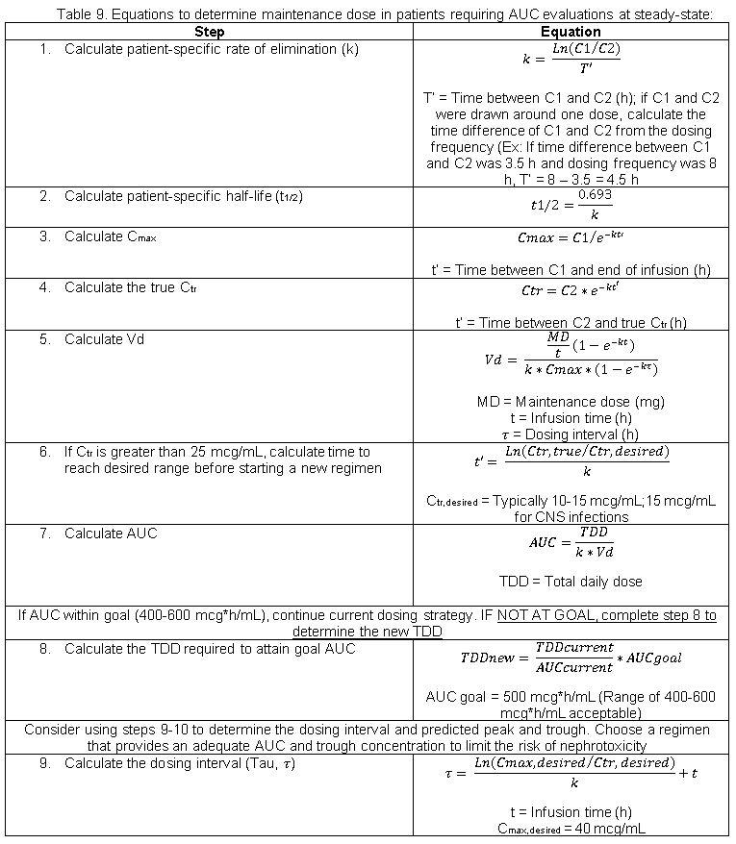
Appendix B. Steady-State AUC Equations

Slide 34
Patient Case: Steady-State AUC Evaluation
C2 (Random): 17.1 mcg/mL at 1130
Vancomycin 1500 mg IV at 1200 over 1.5 h
C1: 34.8 mcg/mL at 1530 (2 h after end of infusion)
PK Factor | Equations* | Result
1. K_{e} | K_{e} = ln (C1/C2) / ΔT | 0.036 h⁻¹
2. C_{max} | C_{max} = C1 / e ^{–k * t’} | 37.4 mcg/mL
3. V_{d} | $Vd= \frac{{Loading Dose}/t (1−e^{−kt})}{k ∗Cmax}$ | 68.1 L (0.802 L/kg)
4. AUC | $$AUC= \frac{TDD}{ke ∗Vd}$$ | 619 mcg*h/mL
* Full list of equations found in Appendix B of the SOP

Slide 35
Maintenance Dose Adjustments
$\frac{{AUC}_{Current}}{{TDD}_{Current}}$ = $\frac{{AUC}_{Goal}}{x}$
$\frac{619}{1500}$ = $\frac{500}{x}$
$x=1211 mg$/day
New maintenance dose options
Vancomycin 1250 mg IV Q24h
Predicted C_{max}: 32.0 mcg/mL
Predicted C_{tr}: 14.4 mcg/mL
Predicted AUC: 516 mcg*h/mL
Vancomycin 500 mg IV Q12h
Predicted C_{max}: 21.1 mcg/mL
Predicted C_{tr}: 14.3 mcg/mL
Predicted AUC: 413 mcg*h/mL

Slide 36
Time for Discharge
Based on the TDM you performed, the patient is discharged on vancomycin 1250 mg IV Q24h
The primary team pharmacist will write a TDM OPAT (Outpatient Parenteral Antimicrobial Therapy) Discharge note prior to discharge
This note should include the following:
Pertinent patient information related to outpatient monitoring of vancomycin
Most recent AUC
Most recent trough concentration
Most recent Vd
Goal trough range
Monitoring recommendations

Slide 37
Clinic Visit: One Week Later
The patient continues on vancomycin 1250 mg IV Q24h and appears to be tolerating the regimen.
Temp 37.4 | BP 120/80 | P 80 | RR 18 | Lactate 0.7
ABW 85 kg | Ht 175 cm | BMI 27.8
She is clinically stable and the Ke and Vd appear to be consistent with her last TDM.
12.8
139
101
7
8.5
358
109
33.3
4.3
19
0.85

Slide 38
Patient Case Continued
OPAT Therapeutic Drug Monitoring
Trough: 16.4 mcg/mL at 1130
Vancomycin 1250 mg IV Q24h administered at 1200 over 1.5h
Concentration
Ctr: 16.4 mcg/mL
Time

Slide 39
OPAT Therapeutic Drug Monitoring
Current dosing strategy: Vancomycin 1250 mg IV Q24h
Example of OPAT Note:
Goal trough range: 10-15 mcg/mL (12.5 mcg/mL for calculations)
Measured trough concentration: 16.4 mcg/mL
Adjust dose by cross multiplication
New dose: Vancomycin 1000 mg IV Q24h or 500 mg IV Q12h
$\frac{{Trough}_{Current}}{{Dose}_{Current}}$ = $\frac{{Trough}_{Goal}}{x}$
$\frac{16.4}{1250}$ = $\frac{12.5}{x}$
$x=953 mg$/dose

Slide 40
Workflow Implications

Slide 41
AUC Monitoring Situations
AUC Monitoring
Early AUC monitoring: 2 concentrations → USED FOR SELECT INDICATIONS
Steady-state: 2 concentrations → AT LEAST ONCE FOR ALL PATIENTS
C1: “VANCOMYCIN 2HR POST DOSE AUC”
C2: “VANCOMYCIN TROUGH” or “VANCOMYCIN TIMED”
Names of orders:
If significant alteration in renal function or Vd occur after the initial AUC evaluation, at least one additional AUC evaluation is recommended

Slide 42
Trough Monitoring Situations
Exceptions to AUC Monitoring:
Unstable renal function or Vd
Hemodialysis or peritoneal dialysis
After the infection being treated appears to be resolving and if renal function and Vd are both stable, trough monitoring every 5-7 days is recommended

Slide 43
Other Considerations
Central lines may be required for therapy longer than 3 days
Doses should not be administered faster than 1000 mg/h
Round doses to nearest 250 mg
Maximum dose: 2500 mg
Administration and Standardized Dosing
Nursing Communication
Contact nursing staff to provide education regarding lab collection
Scheduled doses should not be held by nursing unless specific communication to hold the dose is given by the pharmacist or another provider

Slide 44
Vancomycin Management Standard of Practice

