Slide 1
Vancomycin Update
AUC-Guided Dosing and Monitoring
for the Bedside Nurse
Insert Name/Title/Logo

Slide 2
Learning Objectives
Compare and contrast trough-guided and AUC-guided dosing
Describe the rationale for updating our vancomycin dosing and monitoring protocol
Discuss the role of the pharmacist and bedside nurse in dosing and monitoring vancomycin

Slide 3
Overview of Vancomycin
One of the most commonly utilized antibiotics for patients admitted with an infection
Activity against most Gram-positive organisms, including MRSA, Streptococcus spp., and most Enterococcus spp.
Therapeutic drug monitoring (TDM) is essential to minimize side effects (nephrotoxicity) and maximize efficacy

Slide 4
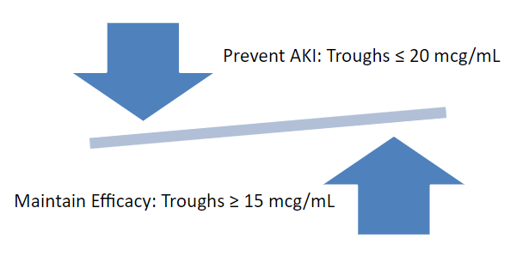
Trough-Guided Dosing
Previous guidelines recommended routine monitoring of serum trough concentrations, drawn 30 to 60 minutes prior to a scheduled dose
The goal level for most patients with severe infectious was 15-20 mcg/mL
However, troughs of 15mcg/mL or more may increase the risk of acute kidney injury (AKI) without improving patient outcomes

Slide 5
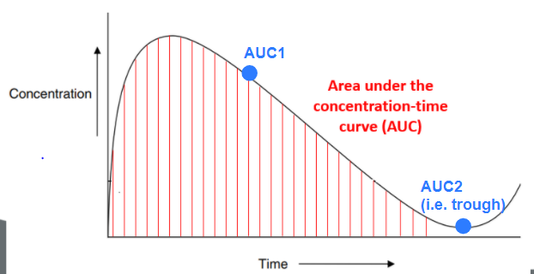
What is Area Under the Curve (AUC)?
New studies show that the most accurate and optimal way to manage vancomycin dosing is by AUC-guided dosing and monitoring
AUC = area under the concentration-time curve (i.e. total drug exposure)
AUC requires TWO LEVELS within a single dosing interval
AUC1 = Peak or Random
AUC2 = Trough

Slide 6
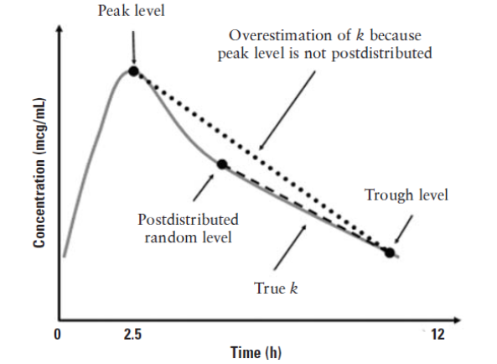
Timing of Levels is Important
Patients receiving AUC-guided dosing and monitoring will need 2 post-dose levels within the same dosing interval
AUC Level # 1
Post-distribution peak or random: usually drawn at least 1 - 2 hours after the end of a vancomycin infusion
AUC Level # 2
Trough: usually drawn 30 minutes prior to
administration of the next vancomycin dose
Note: In the majority of cases there will be a minimum
of 4 hours between these levels
Notes:
Can consider promoting to nursing colleagues that timing of levels has more wiggle room than the rigidity of a single trough.

Slide 7
New AUC Levels in Hospital EMR
Insert picture of EMR screenshots for levels
Vancomycin Level AUC1 (post-distributed level)
Normal range: (insert institution normal values)
Critical value: (insert institution critical values)
Vancomycin Level AUC2 (trough)
Normal range: (insert institution normal values)
Critical value: (insert institution critical values)

Slide 8
When Will AUC Levels Be Drawn?
Vancomycin AUC level 1 and AUC level 2 should be collected within the same dosing interval and after at least…
Vancomycin Interval | Vancomycin Level
 | AUC1* | AUC2* (trough)
Every 8 hours | AFTER 4th dose | BEFORE 5th dose
Every 12 hours | AFTER 3rd dose | BEFORE 4th dose
Every 24-48 hours | AFTER 2nd dose | BEFORE 3rd dose

Slide 9
When Will We Use Trough vs AUC Monitoring?
Patient Ordered Vancomycin
Renal Replacement Therapy (HD, CRRT, SLED, CAPD
Yes
No
Fluctuating Renal Function, Oliguria, and/or Acute Kidney Injury
(defined as ≥ 0.3 mg/dL or ≥ 50% increase in SCr from baseline or last value measured within the previous 24-48 hours)
Yes
No
Vancomycin
AUC-Guided Dosing
Vancomycin therapy for any of the following indications:
Urinary tract infections
Patients expected to receive vancomycin for < 24 hours (i.e. surgical prophylaxis)
Vancomycin
Trough-Guided Dosing
No
Yes
Goal:
AUC 400-600 mcg*h/mL
(with trough/AUC2 between
10-20 mcg/mL)
Goal:
Depends on Indication
10 – 15 mcg/mL
15 – 20 mcg/mL

Slide 10
Role of Pharmacist for AUC Monitoring
Prescribers are responsible for starting the initial vancomycin regimen and discontinuing therapy
Pharmacists (or prescriber) are responsible for dosing and monitoring
Pharmacists will enter doses, levels, and perform calculations to determine the AUC, which will guide subsequent vancomycin dosing
They are encouraged to contact nurses via EMR chat functions or through MAR chart reminders (if applicable) to alert them when the vancomycin serum levels are ordered/scheduled
Look for text comments on the order (or EMAR) for appropriate timing
E.g.,: “please collect vancomycin serum level 30 minutes prior to vancomycin dose scheduled at 2100”

Slide 11
Role of the Bedside Nurse in AUC Monitoring
Assist in the appropriate collection and timing of vancomycin serum levels
Coordinate with Phlebotomy to ensure appropriate timing (if applicable)
Do not hold vancomycin dose to wait for vancomycin serum level to return
Provide timely administration of vancomycin as scheduled (including barcode scanning for documentation purposes)
Improves accuracy and interpretation of vancomycin serum levels
Contact (unit-based, central, ID) pharmacist with any concerns or questions related to collection or timing of vancomycin serum levels
If the second level is due after your shift, please include this in your hand-off to the oncoming nurse

Slide 12
Thank you for improving patient care! (insert logo or picture) Please reach out to your pharmacist if you have any questions or concerns!

